Slide 1


Data Market in China: Policy & Progress
REN Ming
School of Information Resource Management
Renmin University of China
renm@ruc.edu.cn
2026-02-26

Slide 2

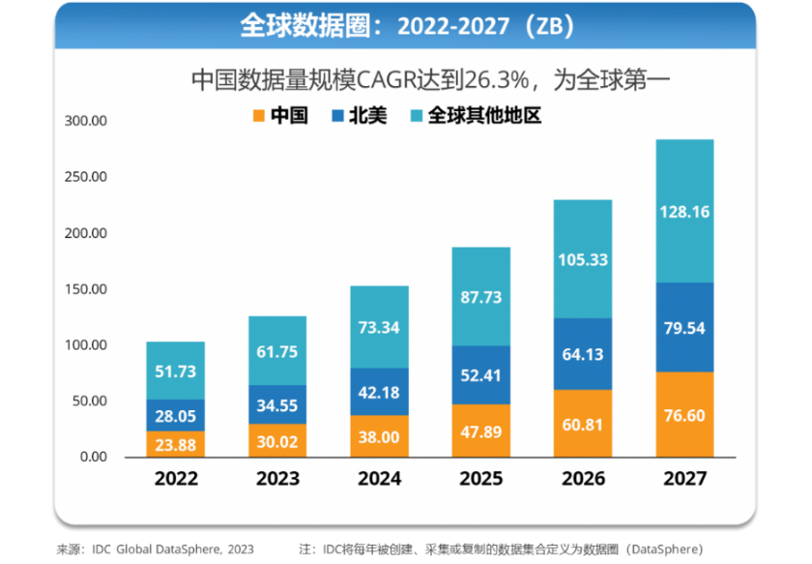
Data Factor & Data Factor Market
first top-level doc on big data Action Plan on Promoting Big Data Development issued by the State Council
19th National Congress Report of the Communist Party of China proposing to promote the in-depth integration of big data and physical economy.
Firstly put forward that “data may participate in distribution as a factor of production according to its contribution”
2015.8
2014.12
2017.10
2019.10
Data recognized as a New Factor of Production
proposing to regard information resources as production factors
2020.4
The 14th 5-year Plan for National Economic & Social Development and Long-term Objectives through 2035 arranging for data property rights, establishing basic systems and standards related to data resource property rights, and cultivating data trading platforms and market entities.
2020.11
20 Data Measures establishing basic data systems
data property rights, circulation & transaction, revenue distribution, security governance
2021.1
Action Plan for Building
a High-Standard Market System proposing to establish data property rights.
2022.12
Our Index project launched！
2022.4
Opinions on Accelerating Constructing a Unified National Market points out that we should accelerate the cultivation of the data element market and establish and improve basic systems and standards such as data security, right protection, cross-border transmission management, transaction circulation, open sharing, and security authentication.
2023.10
2024.01
National Data Administration (NDA) inaugurated
3-year Action Plan for "Data Element Powered (2024-2026)"
promoting the high-level application of data elements in 12 sectors.

Slide 3
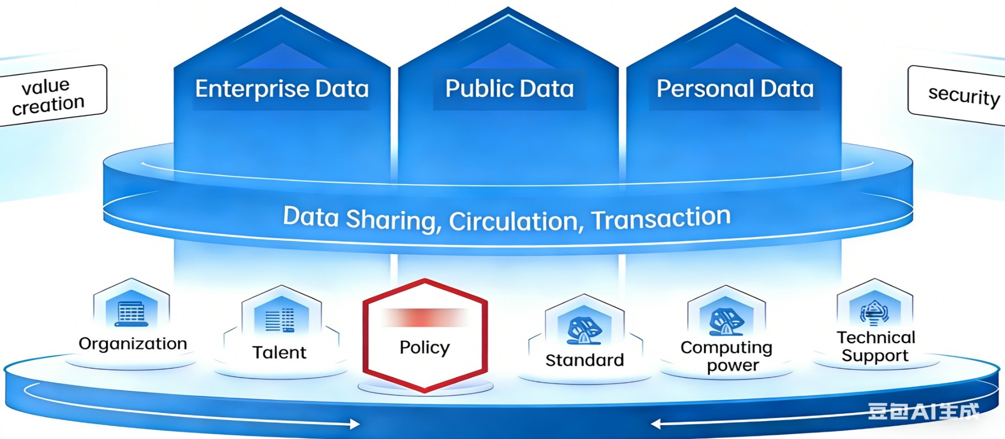
Data Market Construction
Policy:
top-level design
special policies
local supporting measures
Environment
Data right: due to the intangibility, replicability and separability of data, it is difficult to clearly define the ownership, use right and income right of data in different phases;
Data valuation and pricing: no unified and mature valuation standard and pricing mechanism, making it difficult to quantify its market value accurately;
Data supply: insufficient supply of high-quality and usable data, especially the insufficient utilization of public data and the reluctance of enterprises to open up their data;
Data circulation and transaction, the problem of "unwillingness to flow, inability to flow and inability to flow" due to information asymmetry, technical barriers and regional segmentation, etc.; no standardized transaction processes, uneven quality of data products, and difficulty in matching supply and demand; and immature data market ecology, lacking sound professional talents, and data service providers; also, data security and risks, like data leakage, abuse, false transactions, etc.

Slide 4
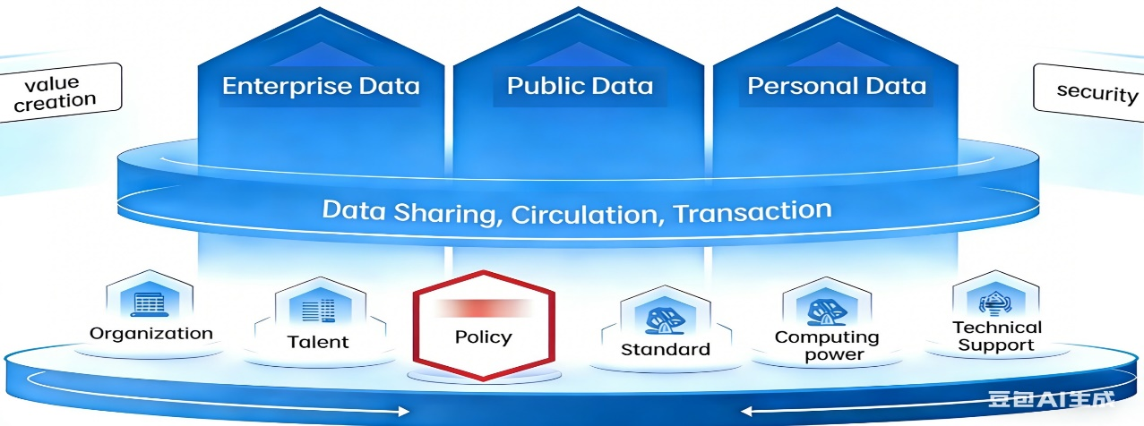
Data Market Construction: Policies
Core Laws
Data Security Law of the People's Republic of China (2021) regulating data processing activities, and clarifying the security obligations of all entities involved in data, becoming the basic law for data security governance.
Personal Information Protection Law of the People's Republic of China (2021) protecting the rights and interests of natural persons' personal information, regulating the collection, storage, use, processing, transmission and other activities of personal information, and providing clear norms for the legal circulation and use of personal data.
Cybersecurity Law of the People's Republic of China (Revised in 2025) optimizing the network security protection system, strengthening the supervision of network operators’ data processing activities, integrating the requirements of artificial intelligence development and data security, and further improving the legal guarantee for data factor circulation and transaction.
Environment

Slide 5
Data Market Construction: Policies
Administrative Regulations
20 Data Measures (2022) clarifying data property rights, circulation and transaction, income distribution, security governance;
Regulations on the Administration of Network Data Security (2024) which regulating network data processing activities and ensuring the safe and compliant circulation of network data;
Regulations on the Sharing of Government Data (2025) as a core regulation for the opening of public data, establishing the principle of
"sharing as the rule, non-sharing
as the exception", and classifying
public data into unconditional
sharing, conditional sharing,
and non-sharing.
Opinions on Accelerating the Development and Utilization of Public Data Resources (2024) guiding the development and utilization of public data;
Interim Measures for the Registration and Administration of Public Data Resources (2025) regulating the registration of public data resources and providing a base and ownership foundation for their opening, sharing and authorized operation;
Implementation Specifications for the Authorized Operation of Public Data Resources (Trial) (2025) regulating the market-oriented authorized operation;
Opinions on Establishing a Pricing Mechanism for the Authorized Operation of Public Data Resources (2025), defining the pricing principles and methods
and balancing the public attribute and
market value of public data.
Environment

Slide 6
Data Market Construction: Policies
Normative Documents
Data
  Opinions on Promoting the Development and Utilization of Enterprise Data Resources, 2024
  National Statistical Survey System for Data Resources, 2025
  Notice on Establishing a Price Formation Mechanism for the Authorized Operation of Public Data Resources , 2025
Technology
  Action Plan for the Development of Trusted Data Spaces (2024—2028) , 2024
  Notice on Organizing the Pilot Work on the Innovative Development of Trusted Data Spaces, 2025
  Implementation Opinions on Promoting the High-Quality Development of the Data Annotation Industry, 2025
  Guidelines for the Construction of National Data Infrastructure , 2025
  Implementation Plan for Strengthening Scenario Applications in the Pilot Construction of National Data Infrastructure, 2025
  Implementation Opinions on Strengthening Data Science and Technology Innovation, 2025
《关于促进企业数据资源开发利用的意见》
《全国数据资源统计调查制度》
《建立公共数据资源授权运营价格形成机制的通知》
《可信数据空间发展行动计划（2024—2028年）》
《关于组织开展2025年可信数据空间创新发展试点工作的通知》
《关于促进数据标注产业高质量发展的实施意见》
《国家数据基础设施建设指引》
《关于在国家数据基础设施建设先行先试中加强场景应用的实施方案》
《关于加强数据科技创新的实施意见》
Environment

Slide 7

Data Market Construction: Policies
Normative Documents
Computing power
  Implementation Opinions on Further Implementing the "Eastern Data, Western Computing" Project and Accelerating the Construction of a National Integrated Computing Network , 2023
Standard
  Guidelines for the Construction of the National Data Standard System , 2024
Talent
  Opinions on Strengthening the Construction of Data Element Disciplines and Majors
  and the Construction of
  Digital Talent Teams, 2025
Utilization
  Notice on Printing and Distributing the Model Text of Data Circulation and Transaction Contracts , 2025
  Opinions on Cultivating Data Circulation Service Institutions and Accelerating the Marketization and Valorization of Data Elements , 2026
  Implementation Plan for Improving the Security Governance of Data Circulation and Better Promoting the Marketization and Valorization of Data Elements , 2025
  Scenarios (Omitted: City, AI Energy, Industry, Agriculture, Logistics, Medical Care, Meteorology, AI Manufacturing, Automobile, etc.）
《关于深入实施“东数西算”工程 加快构建全国一体化算力网的实施意见》
《国家数据标准体系建设指南》
《关于加强数据要素学科专业建设和数字人才队伍建设的意见》
《关于印发数据流通交易合同示范文本的通知》
《关于培育数据流通服务机构 加快推进数据要素市场化价值化的意见》
《关于完善数据流通安全治理 更好促进数据要素市场化价值化的实施方案》
Environment

Slide 8
Data Market Construction: Policies
Local supporting measures
Local regulations:
  Regulations on Promoting the Development of Big Data (Shandong),
  Regulations on Promoting the Digital Economy (Beijing),
  Data Regulations (Hubei)
Local government rules:
  Interim Measures for the Opening and Security Administration of Public Data (Zhejiang),
  Measures for Promoting the Development and Utilization of Public Data Resources (Hainan),
  Measures for the Administration of Data Transactions (Shandong),
  Measures for the Authorized Operation of Public Data (Jinan)
Focus
Security: all attach great importance, some even issued special policies.
Public data authorized operation: almost all provinces formulated relevant management measures or implementation plans, different authorized models including overall authorization, authorization by sector, authorization by scenario, and hybrid.
Data registration: data intellectual property registration, data asset registration, or hybrid. Newly issued policies focus on public data registration.
the charging issue for the authorized operation of public data: a few provinces have released such standards or guidance, following national policy.
data transactions: A few documents, on Measures, Regulations and Standards.
Local normative documents:
  the Action Plan for the Reform
  of Market-Oriented Allocation
  of Data Elements (Guangdong)
  (available in 27 provinces).
cross-border circulation: in exploration, such as formulating negative lists for data outbound management.
Environment

Slide 9
Data Market Construction: Others
Pilot project to encourage local innovative exploration
  China has set up 7 national digital economy pilot zones in 2025, which will conduct pilot experiments around 158 reform measures in seven aspects.
Government guiding, Market dominating
  To clarify the positioning of various market entities, enrich the market ecology, and stimulate the vitality of market innovation;
  To address the difficulty of data exchanges in attracting participants, we promote the transformation and upgrading of data exchanges to achieve a leap towards "ecology operation", encourage public data to enter the market for transactions in a compliant manner, and drive the orderly circulation of enterprise data and social data;
  To establish a national mutual recognition and interconnection demand pool for data exchanges, promote cross-regional and cross-industry coordination of data transactions.
  …
Environment

Slide 10

Data Market Construction: Some Progress
Technology
Organization
Data-related patents over 660,000 nationwide
AI enterprises surpassing 6,000
AI patents account for 60% of the global total
30 provincial-level data groups established nationwide
21 provincial data centers established
More than 530 data-related industry associations
Standard
Data
Data-related standards issued over 1,000
23 accessible provincial-level data open platforms.
More than 480,000 open datasets, with a total volume exceeding 160 billion records
Data utilization in 10+ provinces over 100,000 times
Computing power
China ranks 2 in terms of total computing power
Scale of intelligent computing 788 EFLOPS
Circulation
Challenges
66 data trading institutions established nationwide
Listed data products reaching 35,000
24 data trading institutions issuing initiative on mutual recognition & interoperability.
data property rights need be refined,
data circulation and transactions needs be improved,
integrating data and physical economy need be enhanced,
mechanism for cross-border data circulation to be explored

Slide 11
Thanks for your attention!
REN Ming
PhD, Professor
Vice Dean, School of Information Resource Management
Vice Dean, Institute for AI governance
Renmin University of China

